Slide 1


End User Synchronization
Connect. Collaborate. Accelerate.

Slide 2



Why Do We Need Synchronization?
“ Nanosecond-level clock synchronization enables a new spectrum of timing and
delay-critical applications”
-- Google, Stanford, Exploiting a Natural Network Effect for Scalable, Fine-grained Clock Synchronization
A Precise Time Axis leaps applications’ performance, efficiency and security
3x Distributed Database Throughput |  |  |  |  |  | 80x Timing Accuracy
Site Security w/ Timed Encryption |  |  |  | ↓ Compute |  |  |  | ↓ Network Traffic
Data Consistency |  | Casuality |  |  |  |  | Event Ordering
Just The Tip
OPEN POSSIBILITIES
Connect. Collaborate. Accelerate.

Slide 3



Use Case: Mass Online Platforms
Competitive interactions, like gaming or stock
transactions
Simulating physical reality, have instantaneous actions occurring in multiple simulations on remote machines
Timestamp events occurring on remote machines, and
do judgement at central server
Generates race conditions but want to be fair regardless of latency to the server
Benefit:
Arbitrate causality between remote inputs
OPEN POSSIBILITIES
Connect. Collaborate. Accelerate.

Slide 4

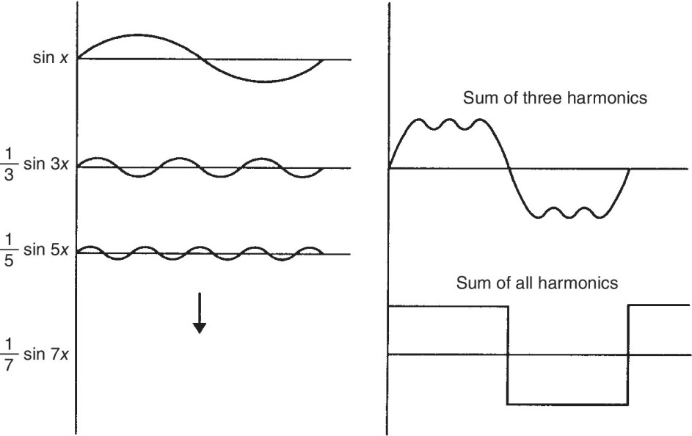
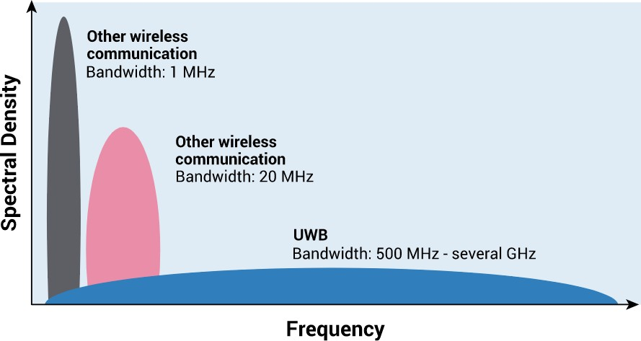
How to sync end users
UWB (Ultra-Wideband)
– IEEE802.15.4-2011 / IEEE 802.15.4z-2020
Large bandwidth approximates ideal square wave better with sharper edges
Sharp edges allow precise timestamping of packet reception and
transmission
Connect. Collaborate. Accelerate.

Slide 5
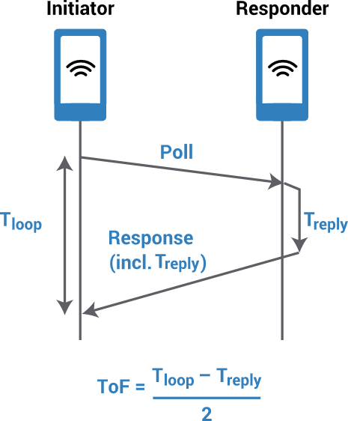
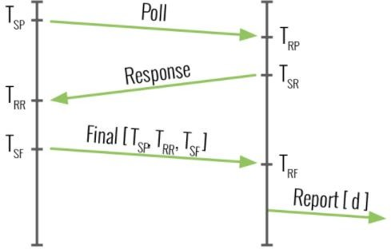
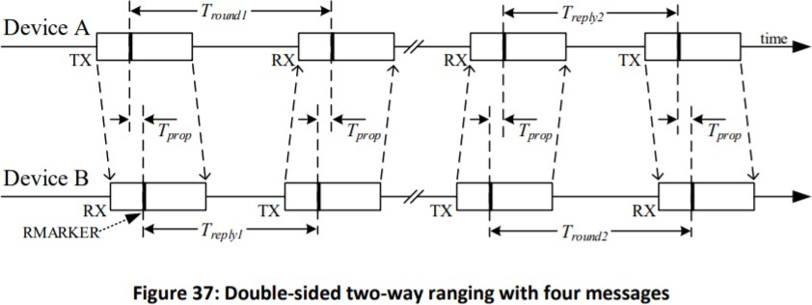
Traditional UWB application
Ranging
UWB devices have a 40-bit counter running at ~64GHz , one tick ~15 ps
Each packet sent or received is timestamped using this counter
Range between devices calculated using Time of Flight * Speed of Light
Accuracy degrades as response time increases, each end has non-ideal
clocks, so time calculations vary with clock frequency variation
OPEN POSSIBILITIES
Connect. Collaborate. Accelerate.

Slide 6

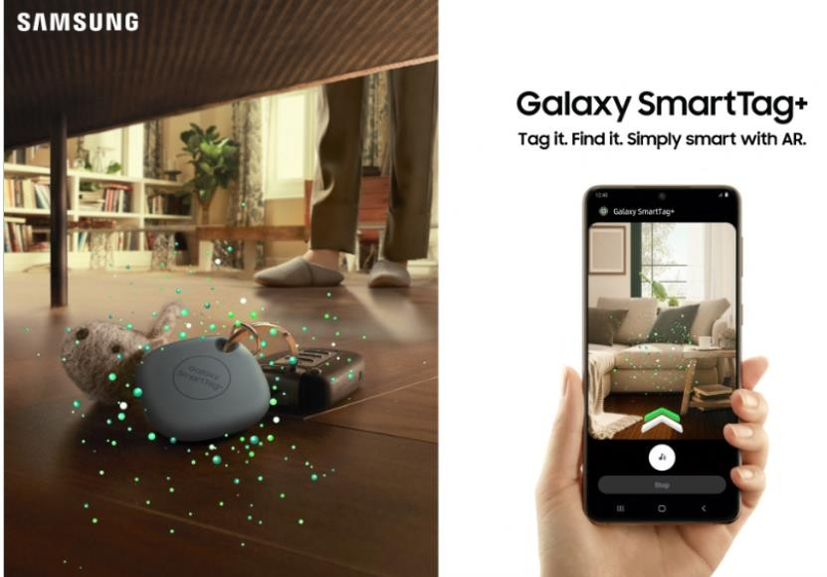
Commercial UWB
Apple Airtags
Use UWB and BLE together to find the distance and angle to the tag from your phone
Samsung SmartTag
Similar to Apple, uses UWB and BLE together with phone’s camera to show you where the tag is
https://engineering.fb.com/2016/02/18/core-data/netnorad-troubleshooting-networks-via-end-to-end-probing/
Connect. Collaborate. Accelerate.

Slide 7



User Synchronization
Synchronize multiple devices to a
single “gateway” with GPS
Provides GPS synchronization to locations without GPS reception
Ideally, this “gateway” function would be built into WiFi routers, or standalone device
Users could install as needed per
household, synchronize every device
GPS Ultra-wideband Gateway (GUG)
UWB Endpoint (M.2
design, Time Drive)
Connect. Collaborate. Accelerate.

Slide 8
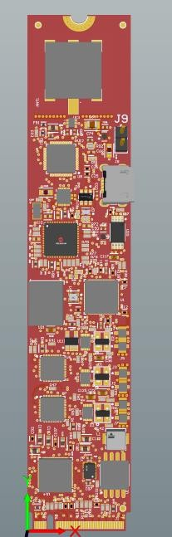
Time Drive
First prototype of a UWB endpoint, M.2
formfactor
Intel I225 NIC chipset as PCIe endpoint
Decawave DW1000 as UWB chipset
Analog Devices AD9546 DPLL
Frequency and phase control, timestamping
input, 1PPS outputs
ATSAMD21 as onboard microcontroller
SiT5711 OCXO for stability
Hardware design to be uploaded soon.
Please contact us if interested in assisting in development
Connect. Collaborate. Accelerate.

Slide 9
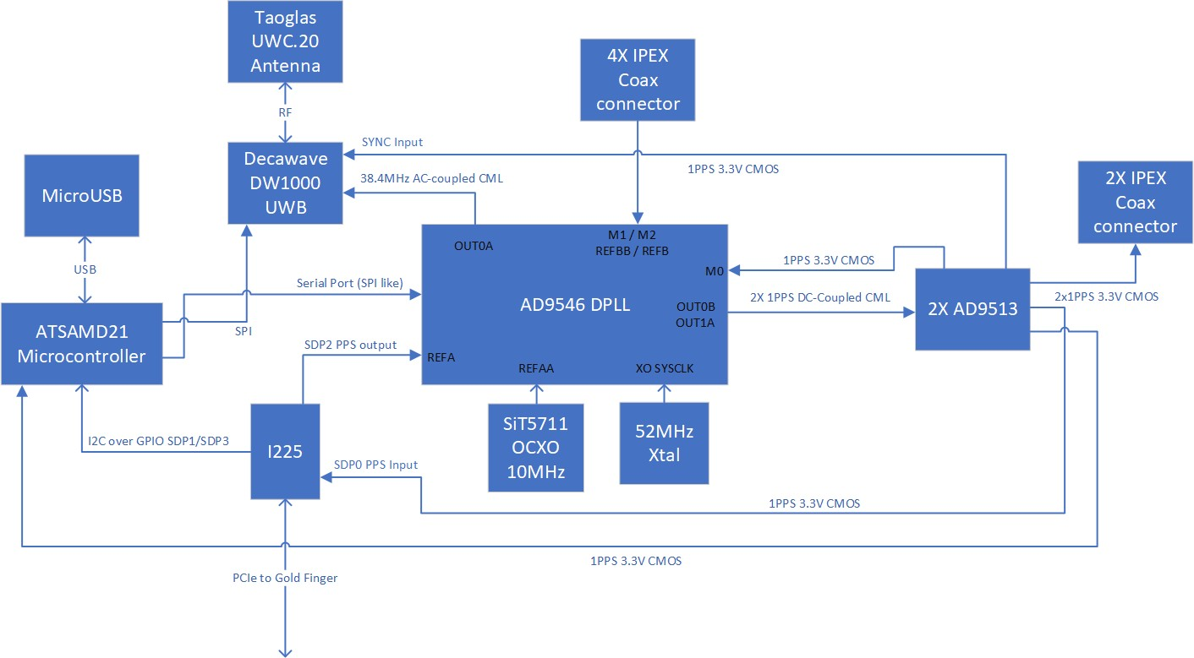
Time Drive Operation
Connect. Collaborate. Accelerate.

Slide 10


Thank You
Connect. Collaborate. Accelerate.

Slide 11
Control Flow In Holdover
ANT L1/L2
PPS
/PCIe
PTP (Ethernet)
PPS
PPS
GNSS
MAC/CSAC
PHC
PHC
ANT L1/L5
PPS
PHC
GNSS 2
PHC
Time Card
PHC
PHC
Open Time Server
Connect. Collaborate. Accelerate.

Slide 12

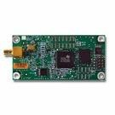
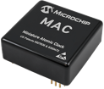
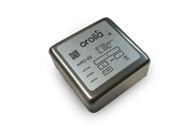

Advanced “GPSDO”
L1/L2
ToD1
GNSS
Receiver1
PPS1
PPS MAC
Optional
L1/L5
Clock Processing FPGA
Discipline
PPS1
High Stability
Oscillator
ToD2
PPS2
GNSS
Receiver2
PPS2
Connect. Collaborate. Accelerate.

Slide 13
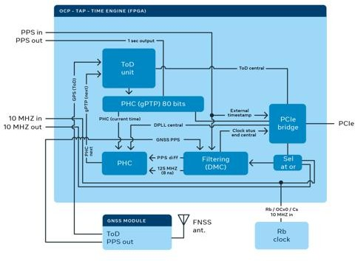
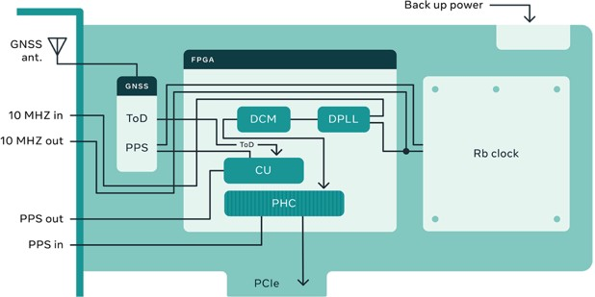
FPGA
Connect. Collaborate. Accelerate.

Slide 14
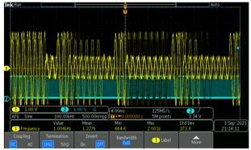
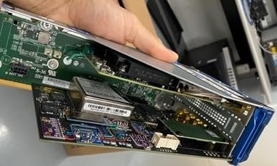
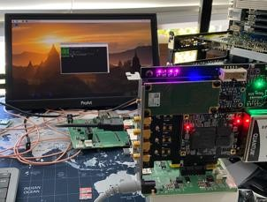
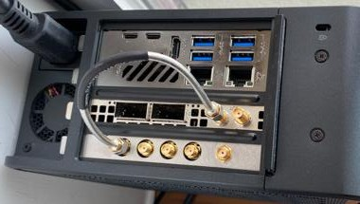
How to use it
For PTP Time Server (Grandmaster)
Via PCIe (PHC2SYS)
Via PPS (TS2PHC)
Via Reverse PPS (in progress)
For NTP Time Server
Via PCIe (Chrony)
For Camera and Audio Systems
IRIG-B
PPS
Other Applications
Bipolar and Multi Channel TDC (Multiple PPS in)
Over PCIe Event Time Stamping
Connect. Collaborate. Accelerate.

Slide 15
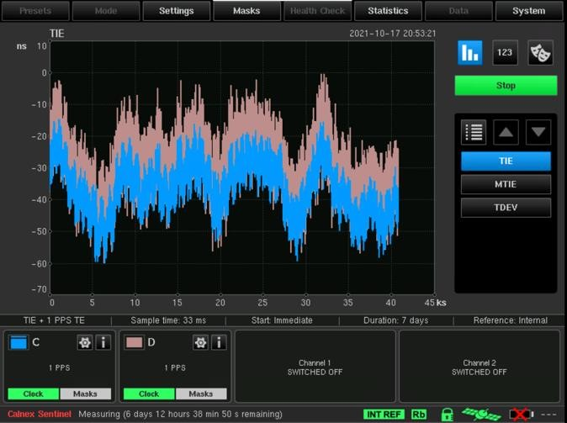
Performance
Time Card
PPS out
NIC
NIC
PPS in
PPS out
PTP over ethernet
PPS out
C
D
Connect. Collaborate. Accelerate.

Slide 16
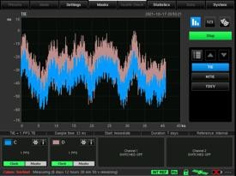
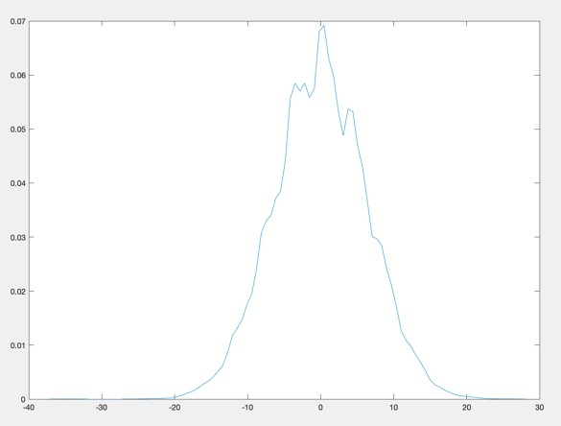
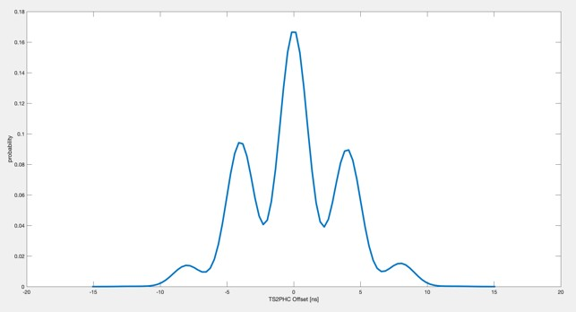
Performance
Connect. Collaborate. Accelerate.

Slide 17
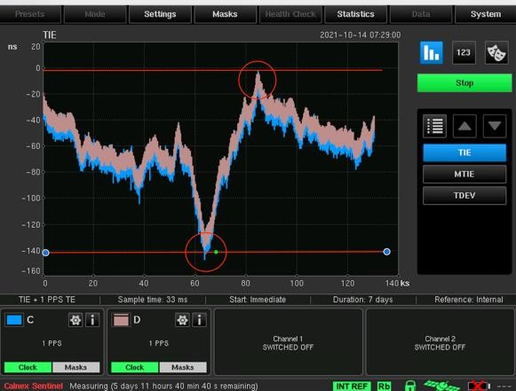
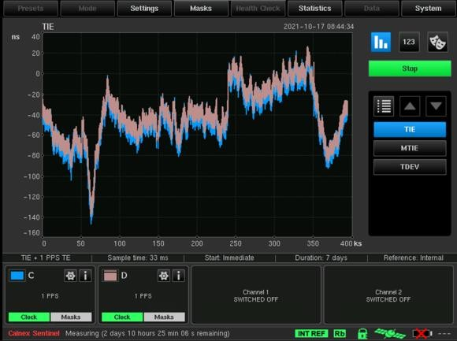
Long-Term vs Short-Term Stability
Connect. Collaborate. Accelerate.

Slide 18
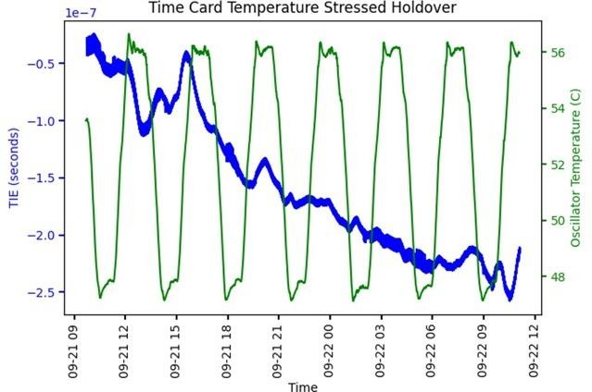
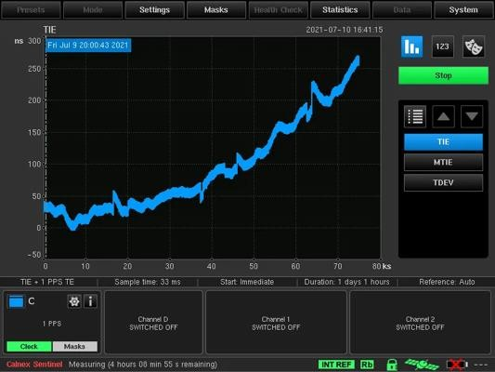
Performance
Connect. Collaborate. Accelerate.

Slide 19
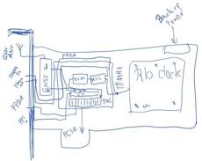
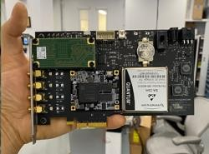
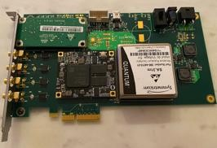
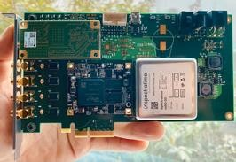
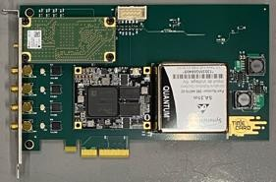
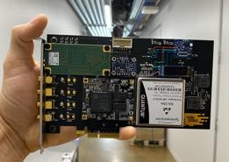
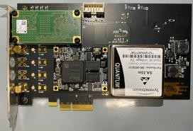
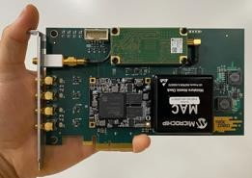
Previous Versions
Sep 2020
October 2020
December 2020
November 2020
February 2021
April 2021
March 2021
July 2021
Connect. Collaborate. Accelerate.

Slide 20
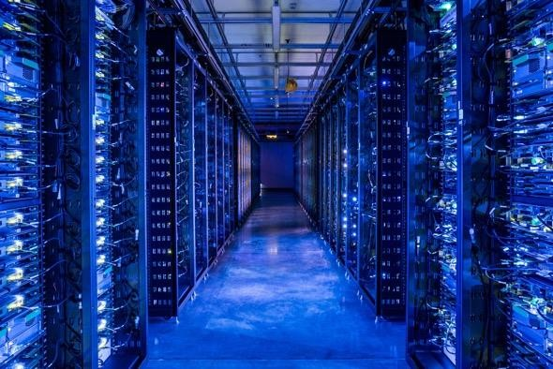
Use Case: Network Telemetry
Constantly pings machines
If machine doesn’t respond, it must take an
action.
Why not do pings based on Hardware Timestamps
SING = Synchronous Pings
One way delay measurements
In-Network Telemetry
Improve Congestion recognitions
Improve Congestion Control mechanisms
End-to-End Precision: <100ns
Want to measure one way latency
Connect. Collaborate. Accelerate.

Slide 21
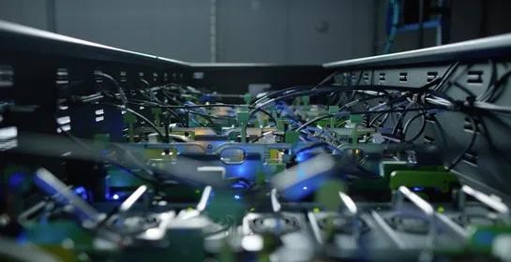
Use Case: Distributed AI
Resource Intensive to move data to one machine or cluster
With the right precision, you can train in many places
Then use the timestamps to
merge the results
Advantages:
Reduces data center traffic/congestion
Save Resources
Requires end-to-end precision of
<100ns
Across the data center
Globally
OPEN POSSIBILITIES
Connect. Collaborate. Accelerate.

Slide 22
Use C ase: Multic ore Systems A c ross the Network
Data Center Network is the Fabric
Ultra-Path Interconnect (UPI) over the network
Input-Output Memory Management Unit (IOMMU) over the network
Can we program a DC like a PC?
We know how to program a Personal Computer well.
Precise time can help us program the Data Center Better
All DC equipment follows the same precise time vector
Benefit:
Current data center loads are far from 100%
Determinism: If you know when everything happens, the load could be closer to 100%
Requires End-to-End Precision of <10ns
OPEN POSSIBILITIES
Connect. Collaborate. Accelerate.

Slide 23
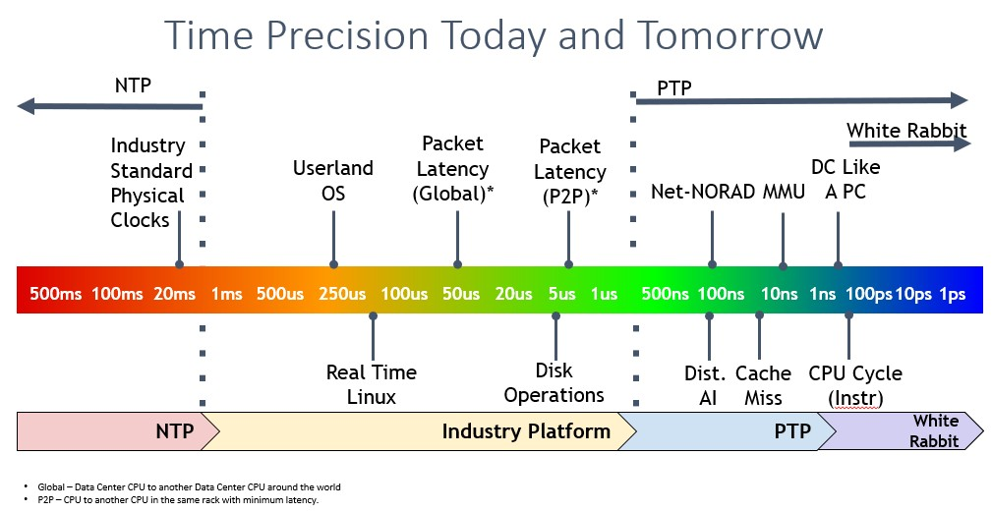
Connect. Collaborate. Accelerate.

Slide 24
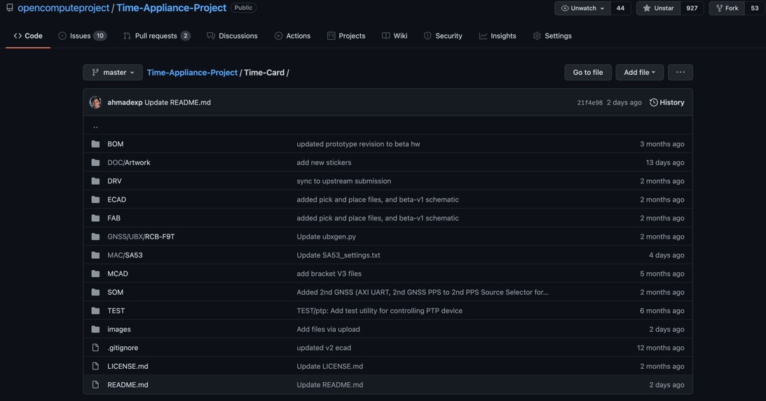
OPEN POSSIBILITIES
Connect. Collaborate. Accelerate.

Slide 25
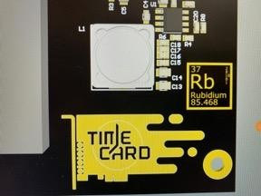
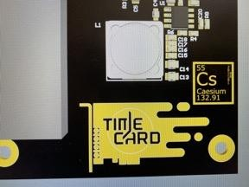
Coming Soon…
Dual GNSS with Rb Clock (SA.53)
Low Power with Cs Clock (SA.45s)
Can be found on www.timingcard.com
Connect. Collaborate. Accelerate.

